Slide 1
Credit One
Data Science Process

Slide 2
Business Problem & Goals
Credit One has encountered an increase in the number of customers who have defaulted on loans and risks losing business if the problem persists. Credit One requires a better way to understand how much credit to allow someone to use.
We will design and implement a creative empirically sound solution:
To decrease the number of customers who default on loans secured
Map a better understanding of how much credit to allow someone to use.
To identify and predict customer default using credit card historical data provided by Credit One.
As a result Credit One we will be able to predict with reliable accuracy the appropriate amount of credit to extend customers to minimize risk of loss of revenue, an increase in number of loan defaults, and loss of clients using their credit scoring services.

Slide 3
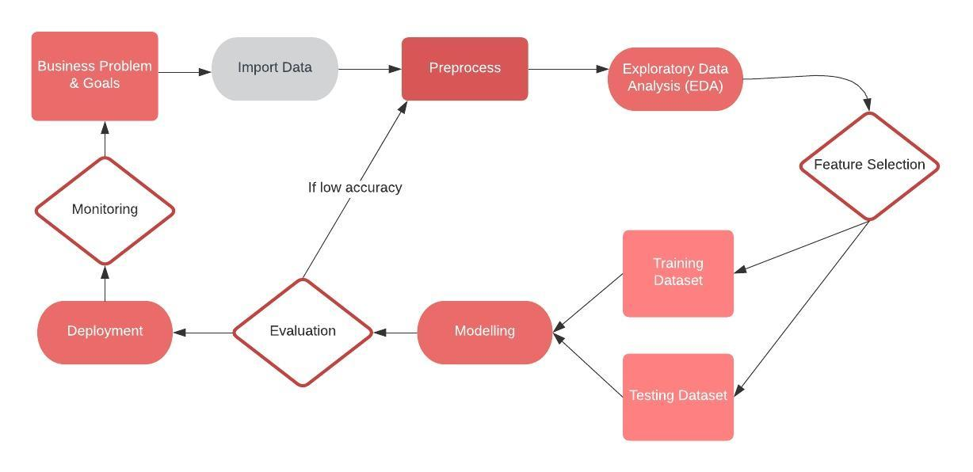
Project Framework
Our process framework based on our data science experience.
Notes:
In preprocessing we will check for issues like missing values, data types that will not work with our tools, and review and transform data. For examples, treating negative values as neutral or as zero.
During our evaluation step we will assess the model performance by examining the overall fit of the model, the significance of each predictor, and the relationship between the target variable and each predictor.
In deployment we will use the model for real-time prediction with additional ‘new’ data.
Ongoing monitoring will allow use to review the the predictability of the model over time and rebuild if necessary as the business environment may change or additional historical data may be provided.

Slide 4
Description of Data
Raw credit card client historical data provided by Credit One:
Approximately 29,000 customer records with
Customer demographics
Age
Sex
Relationship status
Level of education
Customer credit information:
Credit limit
Six month credit standing
Six month bill amount
Six month payment history
credit status (default or good standing)

Slide 5
Data Management
Original raw file and cleaned version will be uniquely saved following client data retention and security policies.
For our data science project we will import and manage data in a Python data analysis library known as a Pandas dataframe.

Slide 6
Issues with the Data
Historical customer data includes an ID field that may skew correlation and modelling studies and should be removed.
The provided historical customer data consists of data types that are mixed types; objects and integers.
Transform the object values to integer values.
Negative values in credit standing fields are not a negative factor. They should be treated as a neutral factor.
Transform the negative values to zero values.

Slide 7
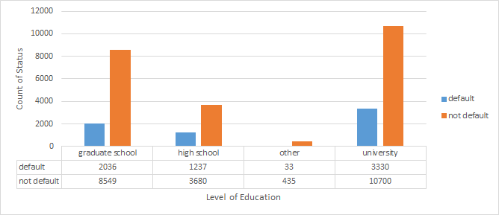
Initial Insights
The average given credit (credit limit) of a default borrower is $130,000.
The highest number of default borrowers are university educated and second highest number of default borrowers hold graduate level degrees.

Slide 8
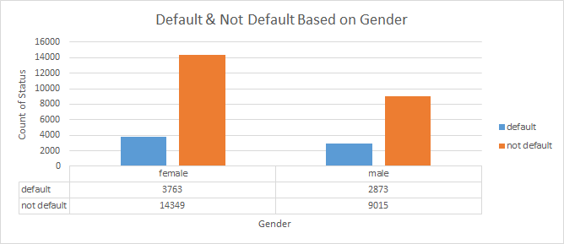
Initial Insights
There are more female borrowers than male borrowers
Female borrowers tend to default more than males

Slide 9
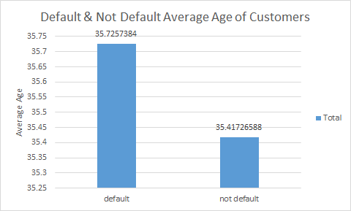
Initial Insights
Average age of a borrower that defaults is 36
Male 37 & Female 35

